Slide 1
W.L. Gore Iliac Bifurcation Aneurysm Model
Chadrick Jennings
Seth Mabes
Nicholas Norris
Noah Wick

Slide 2
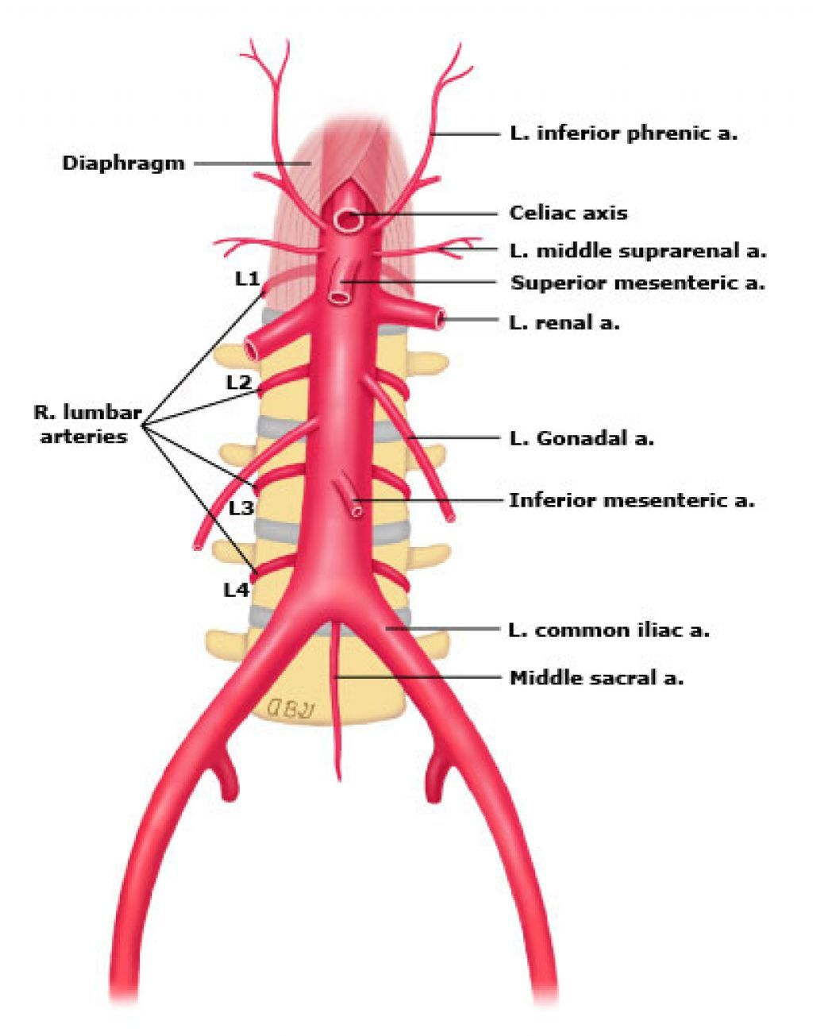
Project Description
Noah Wick

Slide 3
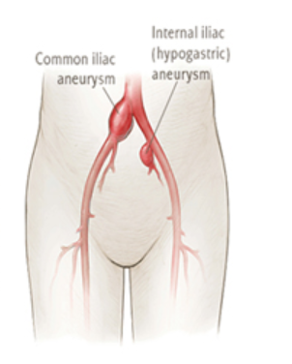
Background
Aneurysm: Abnormal bulge on blood vessel caused by localized weak spot
Aortic-Common Iliac Bifurcation: Location in which aortic artery bifurcates into two common iliac arteries
Rate of occurrence: 2-4% in U.S. Adult Population
Rate of Mortality: 50-70% if rupture occurs
Risk Factors:
Age 50+
Tobacco use
Gender (male)
Coronary artery disease

Slide 4

Project Description
Problem
Create a Realistic Model of the Human Iliac Bifurcation for Peripheral Endovascular Device Testing
Sponsor
WL Gore and Associates
Faculty advisor
Dr. Tim Becker
Importance
Advance medical device technology, Ethical considerations, Ultimately save lives

Slide 5
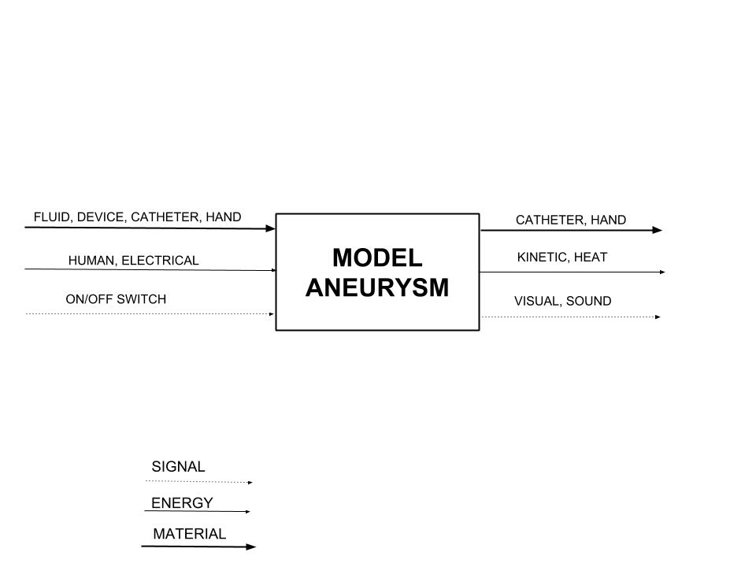
Black Box Model

Slide 6
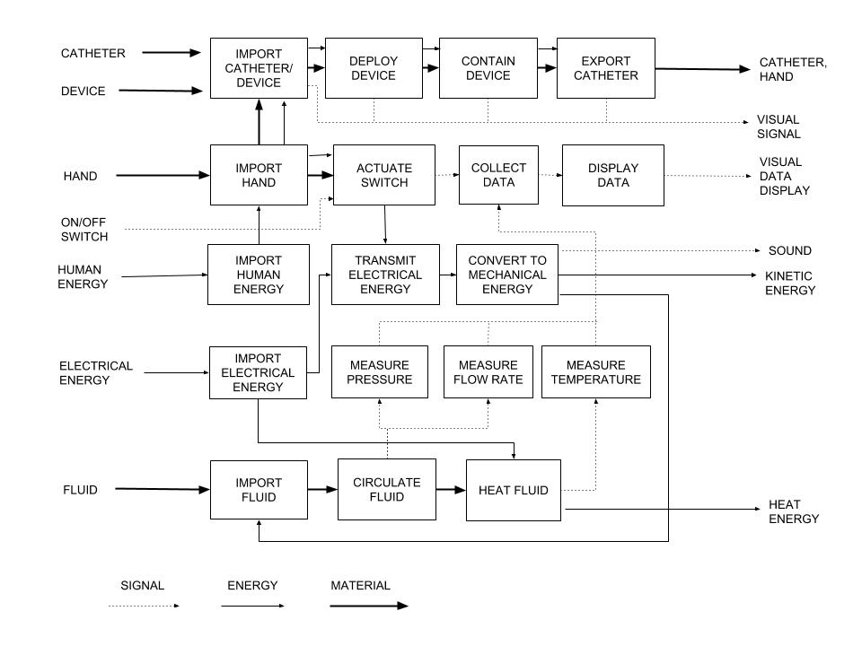
Functional Model

Slide 7
Design Description
Seth Mabes

Slide 8
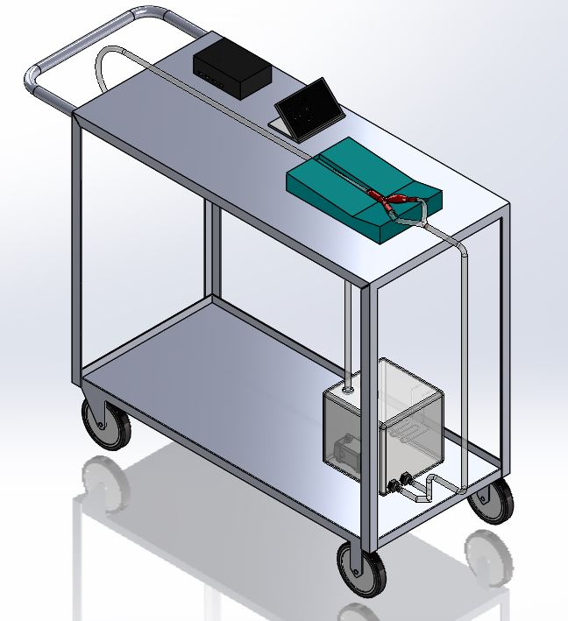
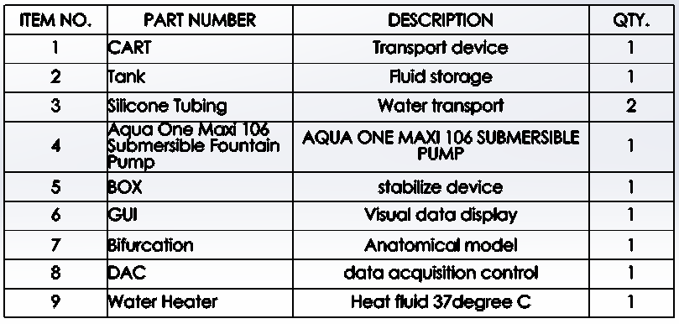
Design Description
8
6
5
7
3
9
2
1
4
Notes:
Seth

Slide 9
Design Description
8
6
The tank holds the fluid
Heater heats Fluid
Pump moves fluid
Tubing carries fluid to bifurcation
Box holds bifurcation steady
DAQ collects data from sensors
GUI displays DAQ data
Cart holds system and allows maneuverability
5
7
3
9
2
1
4
Notes:
Seth

Slide 10
Analyses Summary
The Team

Slide 11
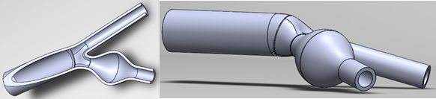
CAD - Solidworks model
Required - detailed understanding of the geometry that makes up the common iliacs.

Slide 12
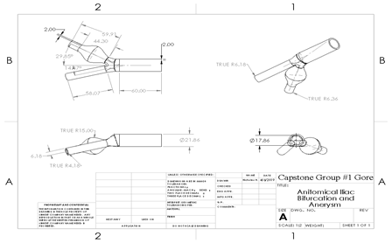
Diameters, lengths, wall thicknesses
The geometric values were averaged from numerous journal articles. These average values were organized and a model was created that matched them. This model was used for flow analysis.

Slide 13
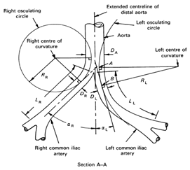
Radii of Curvature and Angles of Take off
These were also taken from averaged data.
This was the most difficult thing to consider
while modeling in solidworks. The bifurcation
had to be castable, anatomically correct, and
be able to be constructed in solidworks.
This took numerous attempts.

Slide 14
Fluid Flow Analysis - Chadrick Jennings
Assumptions
Inviscid
Incompressible
Steady State
Major Losses
Entry lengths for FDF
  Pump to Coupling
  Coupling to Bifurcation
Friction Factor based on Laminar Flow
Minor Losses
Coupling between ‘aorta’ and system
  K-value found online as basic ‘coupling’ [1]
Bifurcation
  K-value found online as ‘y’ fitting [1]
Aneurysm
  Entrance to aneurysm k-value was an average between:
    Sudden Expansion [2]
    Diffuser [3]
  Exit from aneurysm k-value was an average between:
    Sudden Contraction [2]
    Nozzle [2]

Slide 15
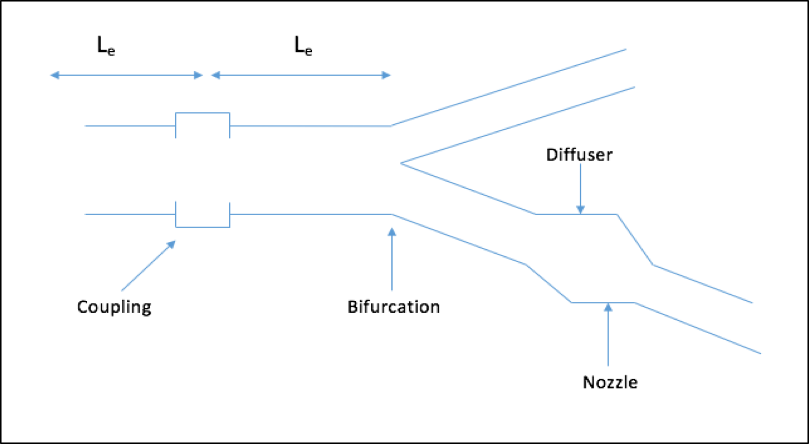

Slide 16
Fluid Flow Analysis (cont.)
Results
Total Head Loss:
Major and Minor added together
h = 0.0014 m^2/s^2
Pressure Drop:
Known inlet pressure from analytical data
Calculated pressure drop over entire system
ΔP = 2.77 Pa
Shear Stress Distribution:
Average diameter used for calculation
Rough estimate for the system
𝝉_rx = -0.019 Pa

Slide 17
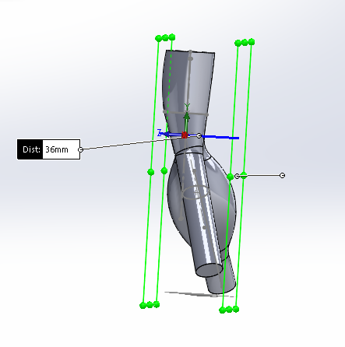
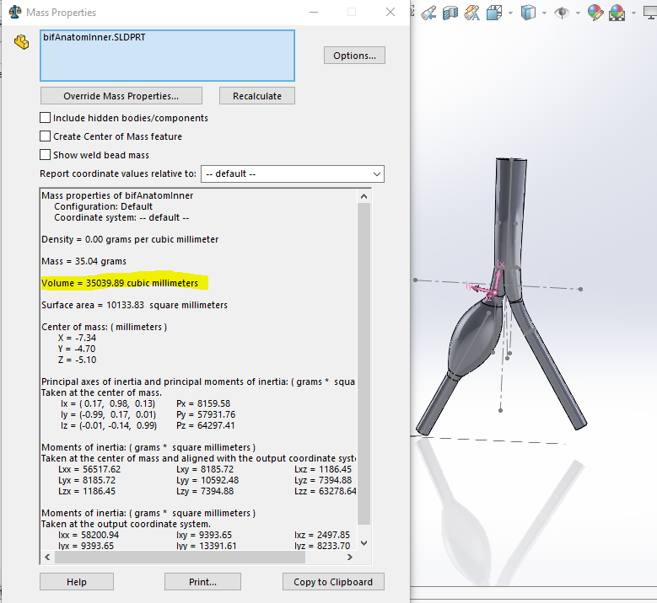
Manufacturing Analysis - Seth Mabes
Goal
  Compare different manufacturing possibilities
    Time, Materials, ease and Overall cost
  Succinct manufacturing process
    Cut lost time and materials
Model Volumes
  Inner /outer
    Mold Volumes

Slide 18
Lost wax method
Materials | Price | Amount | Quantity | Use | quantity to create molds |  | quantity per casting (post silicone) |  | quantity for 13 casts
acrylic 12x24x3/16 | 24.99 | 54 in^3 | 1 | casting box | 1 | sheet | 0 |  | 0
Sulfer-free clay | 13.91 | 5 lbs | 1 | create split zone | 2 | lb | 0 |  | 0
universal mold release | 16.45 | 14 Fl oz | 3 | spray onto molds | 3 | Fl oz | 3 | Fl oz | 39 | Fl oz
3D print | 3 | 1 print | 2 | core for molds | 2 | prints | 0 |  | 0
32 oz mixing containers | 39.96 | 100 cups | 1 | mixing materials | 6 | cups | 3 | cups | 39 | cups
two part silicone | 115 | gallon | 1 | create 2 molds | 0.5 | gallons | 1 | use per mold | 0
paraffin wax | 4.99 | 555 ml | 1 | inner core | 0 |  | 35 | ml (reusable) | 325 | ml
polyurethane | 115 | gallon | 1 | cast material | 0 |  | 14 | ml | 0.2 | gallons
 | total cost of materials |  |  | 355.29 | USD
 | Quantity
Silicone Per mold | 2 | 861 ml | Part A | 376 ml | Part B | 38 ml
Acrylic | 2 | 2 – 130.36mm x 55mm (long side)
 |  | 2 – 109mm x 55mm (short side)
 |  | 1 – 132mm x 109mm (base)

Slide 19
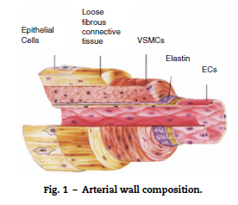
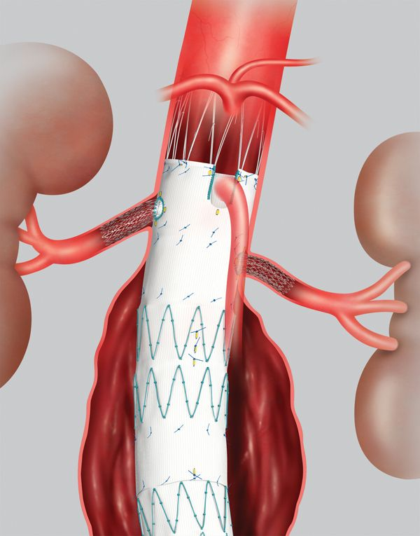
Materials - Noah Wick
Determining Arterial Wall Elasticity/Compliance [4]
  Arteries are Heterogeneous Materials: 3 Concentric layers
      Tunica Adventitia: Outer Layer
      Tunica Media: Middle Layer
      Tunica Intima: Inner Layer
        Medical device interface
  Arteries Exhibit Complex Viscoelastic behavior
      Time, Pressure, Volume Dependent
Hardness [5]
  Measured With Shore Durometer
  Device Sealing

Slide 20
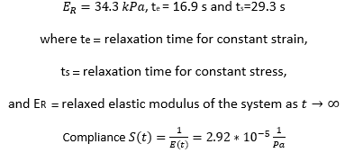
Arterial Wall Properties
Hardness [5]
  No Mathematical Calculations
  Measured with Shore durometer
  41 Shore 00 ~ 5 Shore A
Elasticity, Compliance, Viscoelastic Response [6]
  Intima layer
  Standard linear solid model
    Maxwell Representation

Slide 21
Mechanical Properties of Casting Materials
Hardness
  15 - 40 Shore A
  Softening Agent
    May Increase Viscous Behavior?
Elasticity, Compliance, Viscoelastic response
  Hybrid Rheometer Testing
    Complex Modulus
    Storage Modulus
    Loss Modulus
Viscosity
  Manufacturing

Slide 22
Design Requirements
Chadrick Jennings

Slide 23
Design Requirements
Safe per ANSI/OSHA (10)
Easy to Move (3)
Stable Base (4)
Mimic Anatomical Flow Conditions (8)
Match Aneurysm Mechanical Properties (7)
Match Aneurysm Geometry (9)
Allow Visualization of Device Deployment (9)
Replicable Manufacturing Process (9)
Display Pressure (5)
Display Flow Rate (5)

Slide 24
Design Requirements
How They’ve Changed:
Removed ‘Display aneurysm volume’
Increased ranking of ‘Repeatable manufacturing process’ to 9

Slide 25
Design Requirements
Does the Design stack up?
Aneurysm model with anatomical geometry
Materials selected to closely mimic mechanical properties
Clear materials to see device deployed
Pump with appropriate pressure head to get accurate anatomical flow
Sensors to measure pressure and flow rate
GUI to display data

Slide 26
Schedule & Budget
Nicholas Norris

Slide 27
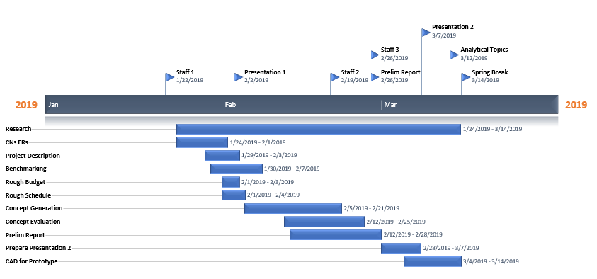
Schedule

Slide 28
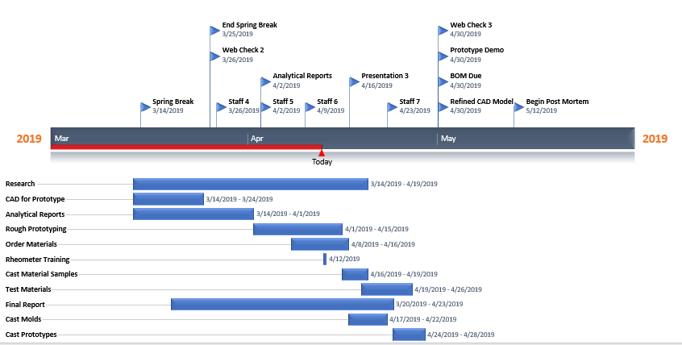
Schedule

Slide 29
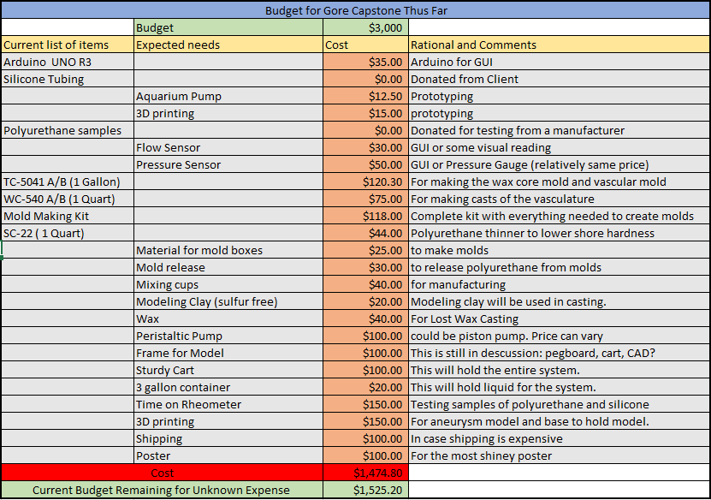
Current Budget

Slide 30
References
[1] Neutrium.net, ‘Pressure Loss from Fittings - Excess Head (K) Method’, 2012. [Online]. Available: https://neutrium.net/fluid_flow/pressure-loss-from-fittings-excess-head-k-method/. [Accessed: 06- April- 2019]
[2] P. J. Pritchard, J. W. Mitchell, Fox and McDonald’s Introduction to Fluid Mechanics, 9th Ed. United States of America: Wiley, 2015.
[3] E. F. Brater, H. W. King, ‘Handbook of Hydraulics’, 7th Ed. Boston: McGraw Hill, 1996.
[4] C. Maclean, "Shore OO Hardness Measurement of Bovine Aorta and Mock Vessel Materials for Endovascular Device Design".
[5] G. E. M. et. al., "Arterial Compliance," in Cardiovascular Medicine, London, Springer, 2007, pp. 1811-1825.
[6] A. Lundkvist et al, "Viscoelastic Properties of Healthy Human Artery," in Materials Research Society Conference Proceedings, San Francisco, CA, 1998.

